Slide 1
Presentation 2: Coders
Hannah Ma, Sharon Lin, Ryan Lach, Nathan Jung, Sari Eisen

Slide 2
Task: patch images
Build algorithm that:
Takes slice image as input (annotated with classifications)
Draw square patches around the epithelium region of image
Ensures that each patch contains only one class
Ensure each patch includes the entire width of the epithelium
Outputs patched images and individual patches
Notes:
Sari

Slide 3
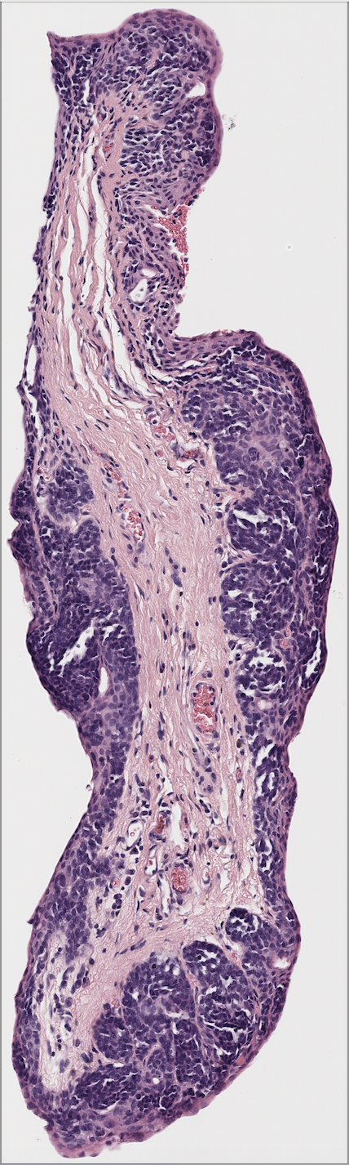
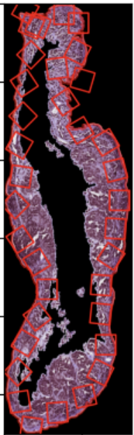
Notes:
Sari

Slide 4
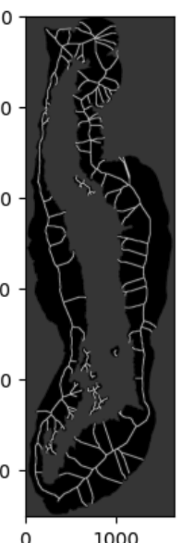
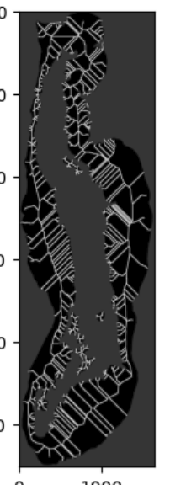
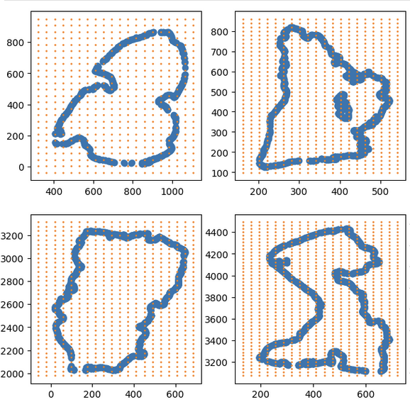
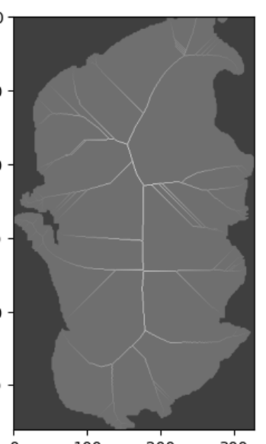
Other Attempts
Notes:
Nathan
Attempted to use grid of squares to then use some type of algorithm to choose which set of squares would be best to cover an area of the cell to make a patch
Attempted to make use of Aryaman’s code using his logic with morphology.skeletonize and maybe use in combination with previous attempt, but just looking at the skeleton reveals issues getting the center line with this method. First full slice is using 3d morphology.skeletonize method and second full slice is using 2d morphology.skeletonize method. Evidently, hard to get the center line properly.

Slide 5
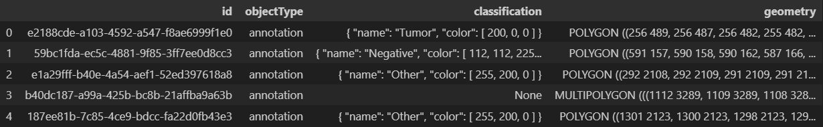
Cells Overlapping Classes
One potential problem our group identified was that if cells were to be created across an entire annotated cell, that some or many may include portions from multiple classes
Exporting the annotation objects as GEOJson files and then masking may alleviate this issue
Can deal with each annotation individually and avoid any issue of overlap
Notes:
Ryan

Slide 6
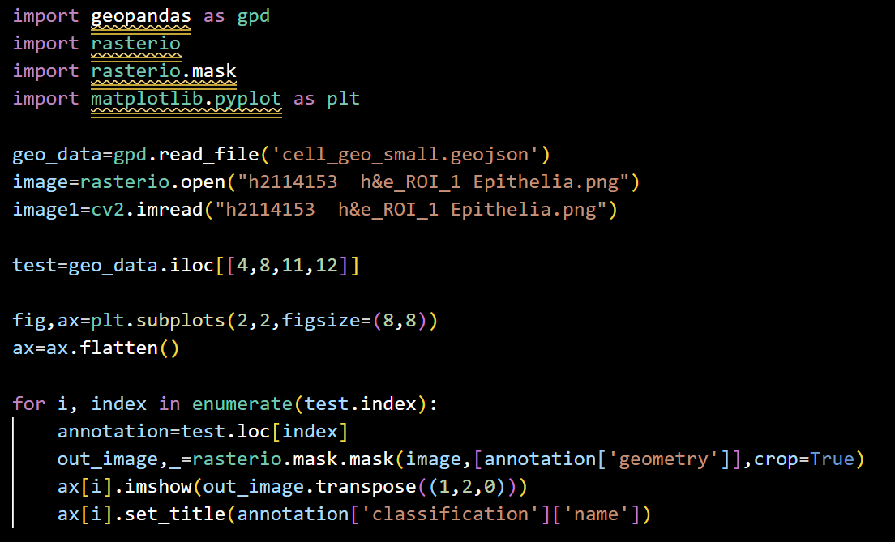
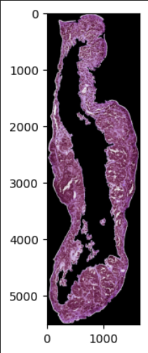
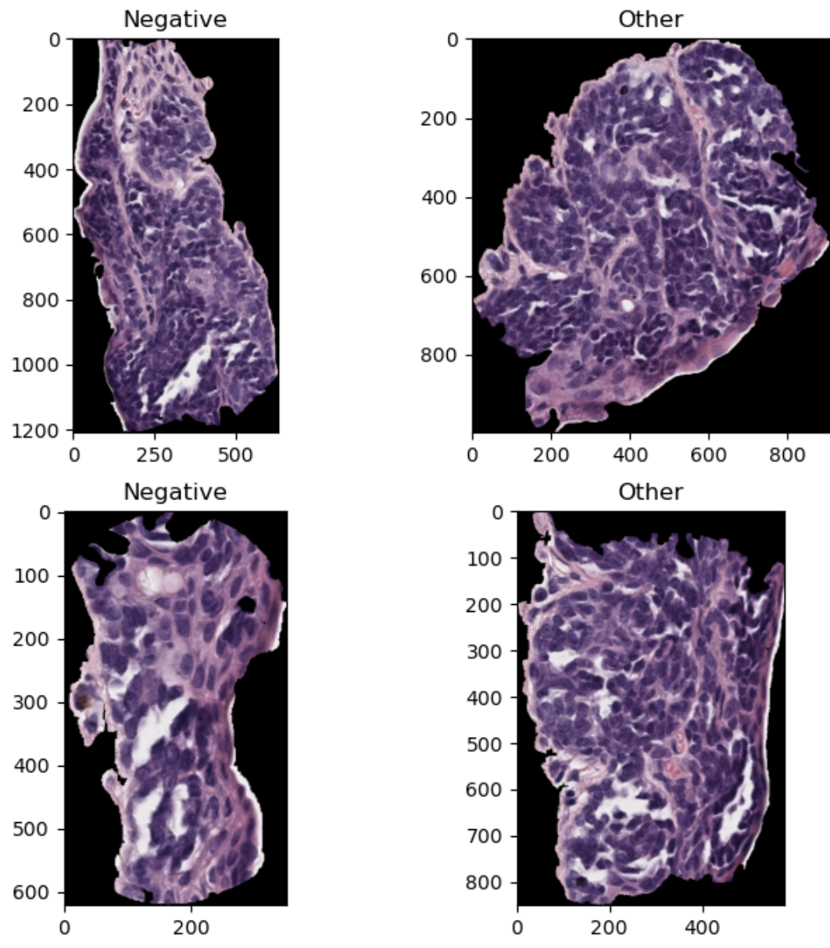
Annotation Extraction Example:
Notes:
Ryan

Slide 7
Potential Additional Approach to Cell Grids
When attempting to grid over the entirety of annotated masks, an approach was found that may prove useful for creating a grid over an entire cell
It creates a square that is normal to a point along the outermost contour, with its top edge tangent to the contour
This allows the squares to point “into” the cell and capture as much as possible
This approach is currently set to use squares of size 256x256 with little to no overlap, but can be adjusted as criteria shift for the project
Can adjust square size, % overlap allowed, step size between initial squares
Notes:
Ryan

Slide 8
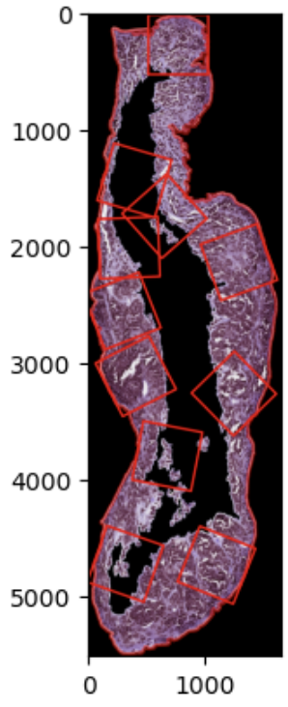
Potential Next Steps
From Arg Tuning:
Refine the process by which squares are defined as overlapping
Initial refinement catches many but not all, add more nuanced approach for remaining squares
Add additional check that compares overlap for all remaining squares
Add additional smoothing measures to prevent squares from jutting out
Extend normal lines until “stroma” class or black pixel is reached to cover width of epithelium
This would create rectangles of varying shapes across the cell
Notes:
Ryan

Slide 9
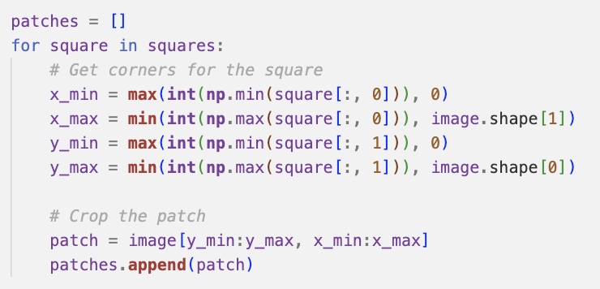
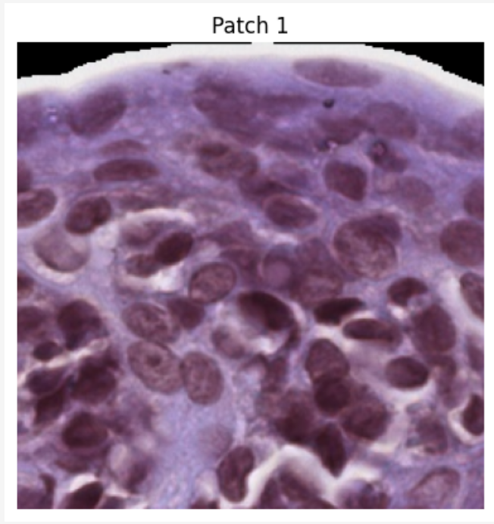
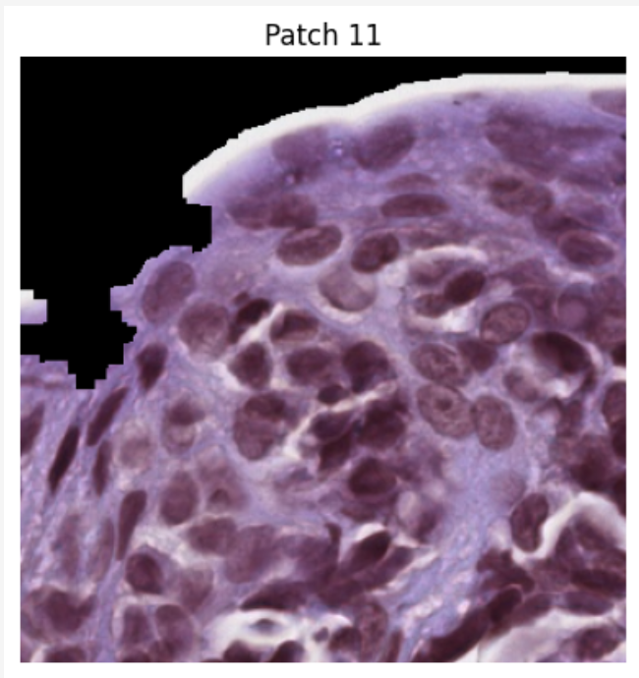
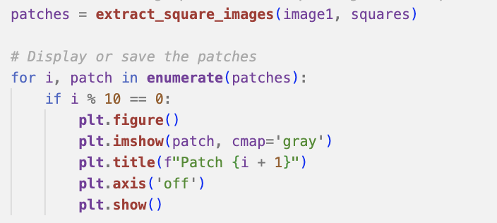
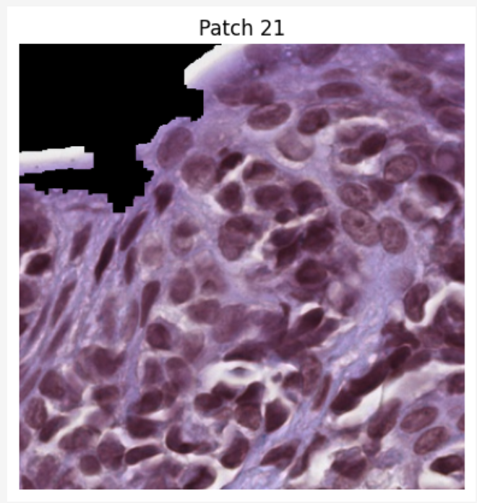
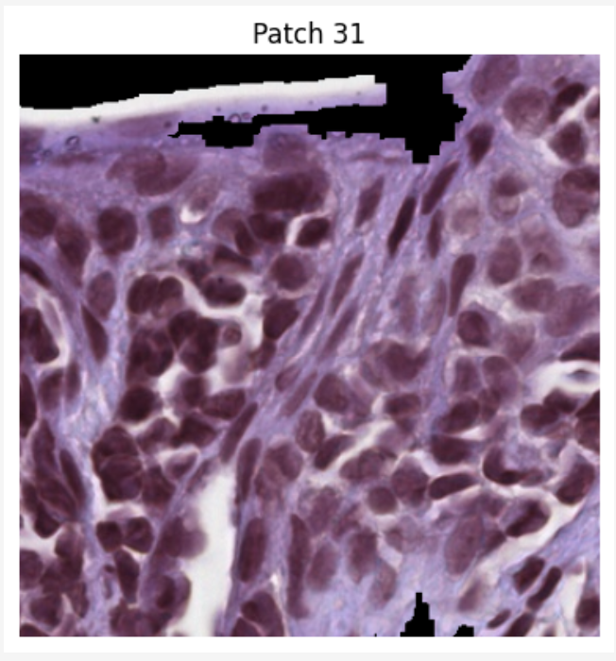
Extracting images from patches
Notes:
Sari

Slide 10
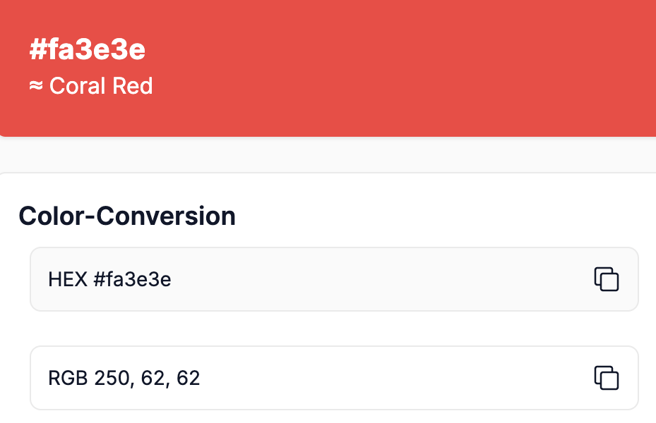
Another Approach: RGB Detection
Manually label epithelium region of sample tissue slice on QuPath with three colors (e.g. red, blue, gray)
Use RGB values of each color (along with white background) to create mask and detect each labelled region
Can identify RGB values of each color by importing labelled image into color classifier online
Patch on labelled image, then transfer patches to original image
Uses patching code developed in Fall 2024, with various modifications
Notes:
Sharon

Slide 11
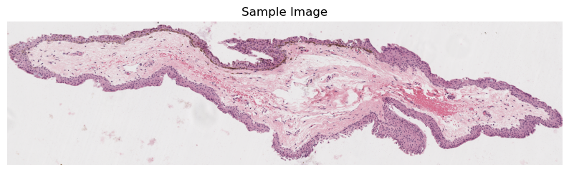
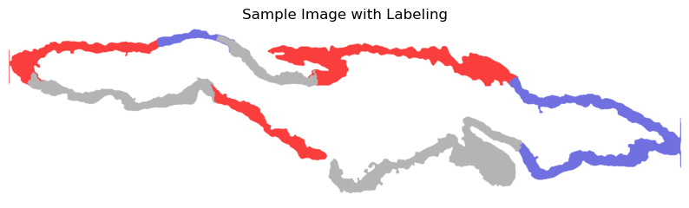
Notes:
Sharon

Slide 12
Modifications to Alyssa’s Code
Not allowing square patches to overlap
Making square patches size vary by multiples of 2 (1024, 512, 256)
Making patches with only one label/color (benign/low-grade/high-grade)
Ensure each patch is at least 50% epithelium and at most 90% epithelium
This is different from the definition of “cover width of epithelium” we previously discussed in class!
Class: two opposite corners of patch are “white space”
Implementation: at least two “white spaces” in patch
Notes:
Sharon

Slide 13
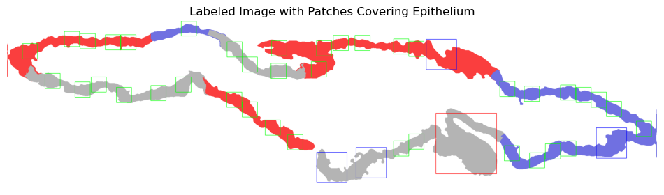
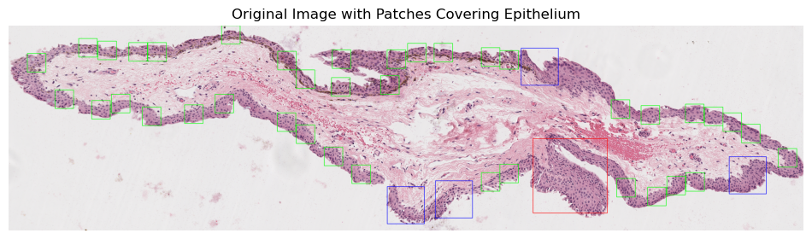
Notes:
Sharon

Slide 14
Potential Next Steps
Make patching algorithm run more efficiently
Decrease time complexity (eliminate redundant/unnecessary code from Fall quarter)
Capture more epithelium regions (make the most use of every slice)
Rotate patches to better capture epithelium regions
Add label (benign/low-grade/high-grade) to each class and export patches so that they could be used for ML model
Think about patching consistency across three stains
Notes:
Sharon

Slide 15
Alternative software exploration
PatchIT looked promising – unfortunately it’s written for use in MATLAB
Any MATLAB users in Testers?
Other software to potentially explore/co-opt into our pipeline:
WSITools - compatible with parsing QuPath annotations, extracting patches, and possibly matching slices
CLAM - data efficient WSI classifier, capable of fully automated patch extraction
PyHIST - segments tissue slices for machine learning tasks
Cerberus - Simultaneous tissue segmentation and classification

